Slide 1

OmH, FHIR and Beyond
November 5, 2018
SF MeetUp

Slide 2


Simona Carini, MS
Data Scientist, Open mHealth
Research Scientist, UCSF
David Haddad, MA
Co-Founder & Executive Director,
Open mHealth
CEO, Overlap Health
Ida Sim, MD, PhD
Co-Founder Open mHealth
Professor of Medicine, UCSF
Jon Duke, MD
Dir, Health Informatics
Georgia Tech College of Computing
Eric Haas
President and CEO
Health eData, Inc
Eric Soto, MS
Research Scientist
Georgia Tech Research Institute
Notes:
Kathryn our program manager

Slide 3
mHealth -- EHR
David Haddad
Open mHealth and Overlap, Inc
November 5, 2018
SF MeetUp

Slide 4
Use Case Overview
Ida Sim
UCSF and Open mHealth
November 5, 2018
SF MeetUp

Slide 5

Increasing Physical Activity to Reduce CV Risk
Patient with moderate CV risk
Joint Goal Setting
Data Prescription
Joint Data Review
AHA/CDC guidelines: 150 minutes moderate activity per week
4000 steps per day
+
Primary Care Physician

Slide 6

Patient with moderate CV risk
Joint Goal Setting
AHA/CDC guidelines: 150 minutes moderate activity per week
4000 steps per day
Primary Care Physician
Joint Data Review
Data Prescription
+

Slide 7
Data Prescription
Joint Data Review
+

Slide 8
Common Data Schemas
for Mobile Health Data
Simona Carini
UCSF and Open mHealth
November 5, 2018
SF MeetUp

Slide 9
Increasing Physical Activity to Reduce CV Risk
Patient with moderate CV risk
Joint Goal Setting
Data Prescription
Joint Data Review
AHA/CDC guidelines: 150 minutes moderate activity per week
4000 steps per day
+
Primary Care Physician

Slide 10
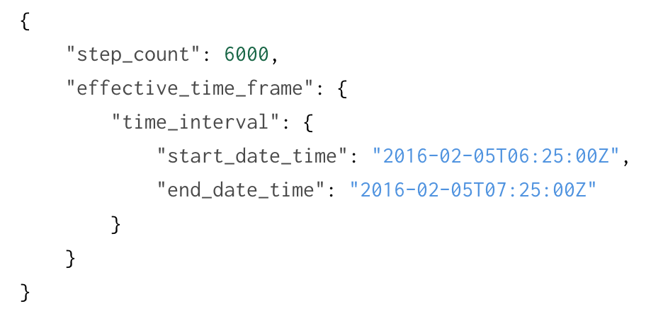
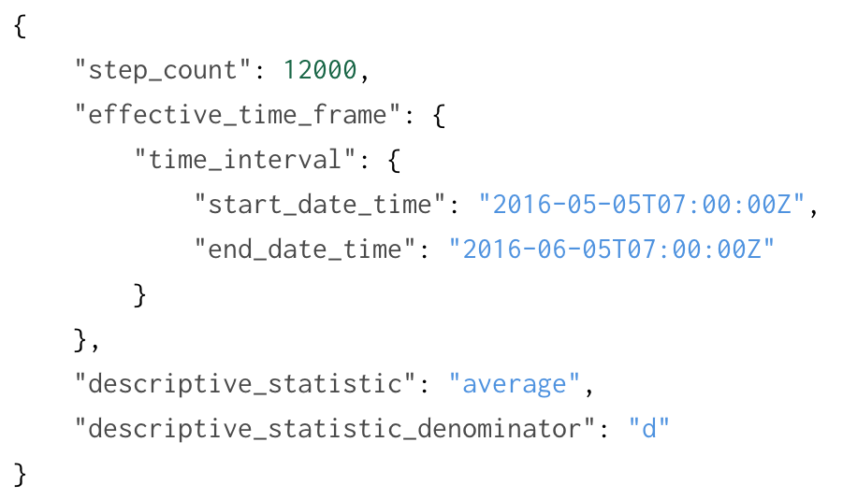
Example Instances of Step Count
Notes:
The schemas allow us to be clear and complete, optional properties to allow 80/20 things ***for mHealth*** to be said.
Simona’s note: something here about the fact that OmH is concerned about the semantics of the data

Slide 11
To answer use case
"properties":
"step_count": number
"effective_time_frame": time interval
"descriptive_statistic": value set that includes average
"descriptive_statistic_denominator": value set that includes day
"met_value": number
Mobile health data and metadata standards are needed
Make data aggregation across multiple sources easier and more accurate
Reduce costs of using mHealth data to make biomedical discoveries, improve health, manage disease
Facilitate development of digital biomarkers and their use in observational studies and clinical trials
Notes:
Each device maker / app developer decides how to represent data and metadata
Data are poorly specified

Slide 12
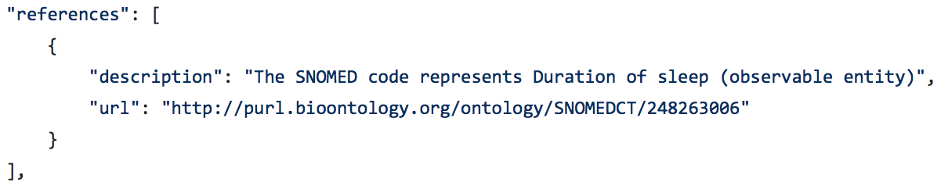
Open mHealth Schemas
A schema structures data and follows design principles
Each data point, includes
header (data point ID, body schema ID, creation date-time, ...)
body (typically a measure, i.e. instance of a measure schema)
annotation to SNOMED, LOINC, RxNORM, or UCUM
Notes:
82 published, but 2 deprecated, so approx. 80 unique, about half of them model quantitative measurements (e.g., step count, blood pressure, heart rate) plus 10 schemas modeling surveys and their elements, plus several under development (e.g., device and app for provenance)

Slide 13
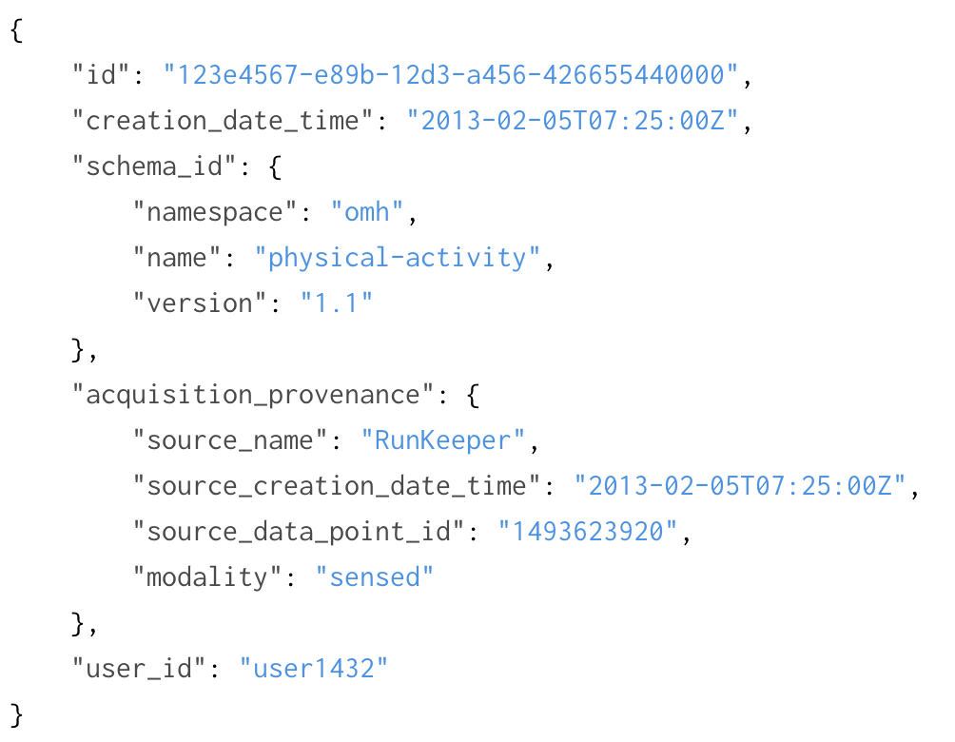
Example Header Instance
Notes:
Additional provenance (processing, data lineage) per MD2K/BD2K
Working with Zach Ives and Santosh Kumar, mProv Project
Working within the context of IEEE standards P1752 Working group

Slide 14
Conclusion
Standardizing mHealth data and metadata will promote data aggregation and improve use of mHealth data for discovery and care
Open mHealth provides clean, clear semantics indexed to standard vocabularies and optimized for mHealth use cases
Open mHealth community is growing, and will be further driven by
mFHIR Implementation Guide
IEEE P1752 standards process
http://openmhealth.org/
http://sites.ieee.org/sagroups-1752/

Slide 15

Introduction to FHIR
Eric Haas, MS, DVM
Nov 5, 2018

Slide 16

What is FHIR?
- Healthcare records are increasingly becoming digitized. - Patients move around the healthcare ecosystem
- HL7 in the business of meeting these challenges for over 20 years producing healthcare data exchange and information modeling standards for over 20 years.
FHIR is a new specification based on emerging industry approaches

Slide 17
What Makes FHIR Different?
- A strong focus on implementation: fast and easy to implement
- widely used RESTful practices and web standards
- Multiple implementation libraries and reference implementations
e.g.,Official API code libraries in Java and .Net to help you work with the standard.
- examples available to kick-start development

Slide 18
Important Pieces of FHIR
At its core, FHIR contains a few primary components….

Slide 19
FHIR Resources
FHIR is based on "Resources" which are the common building blocks of content models (notionally equivalent to a physical model implemented in XML or JSON)
- Common metadata
- Set of defined data elements
- Extensible
- Allow for human readability
- JSON, HTML, RDF representations

Slide 20
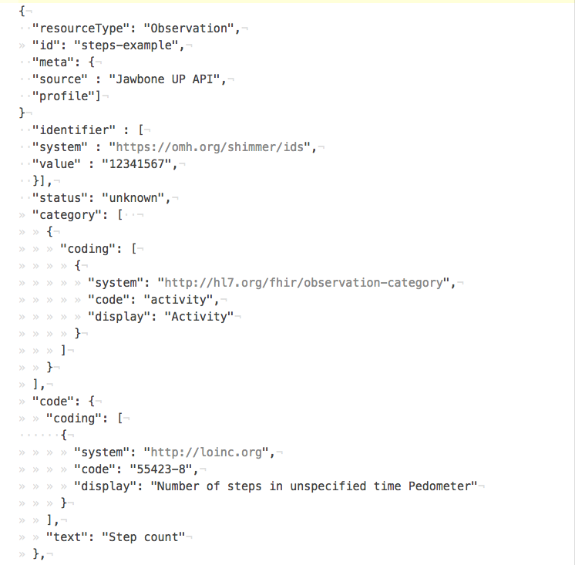
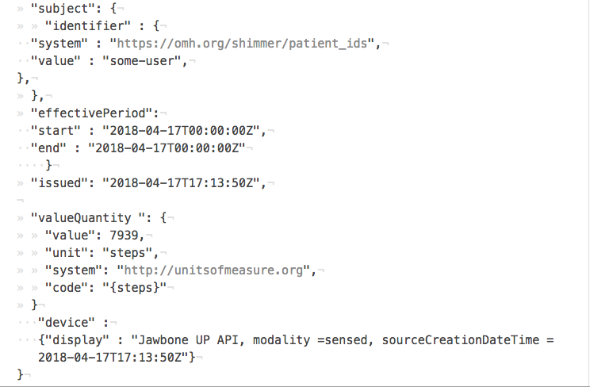
Notes:
Example of FHIR Observation Resource as a JSON object

Slide 21
FHIR RESTful APIs
Although not required, the FHIR specification targets RESTful interfaces for API implementation
The RESTful API defines a set of common interactions
Read
Update
Search
etc

Slide 22
Terminology
FHIR has a strong emphasis on terminology
- ValueSets
- CodeSystems
- Terminology Services

Slide 23
Other FHIR Capabilities
Other capabilities defined as well
- Operations*
- FHIR Messaging
- exchanging FHIR Documents
- asynch
- GraphQl
- Persistence/Data bases
Notes:
A RPC-like paradigm defined where named operations are performed with inputs and outputs:

Slide 24
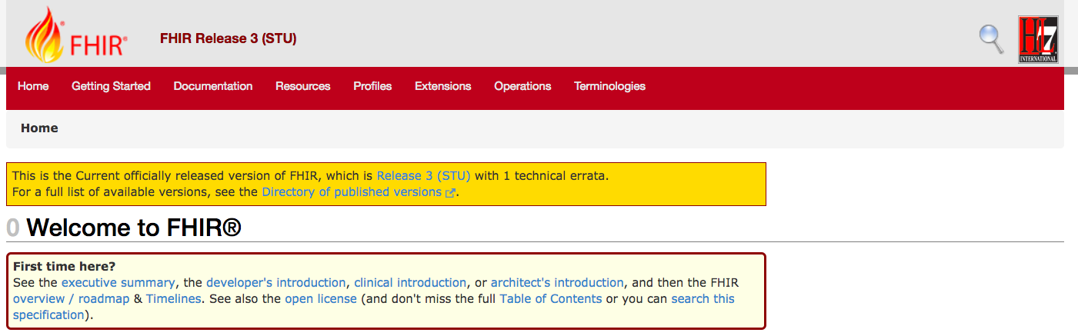
Experiencing The Base Standard
Current Official Published Version (Currently: Release 3 with 1 technical errata):
http://hl7.org/fhir/index.html

Slide 25
A Word About Versions
Several Published Versions of FHIR and a *CI Build*
Current Official Published Version (Currently: Release 3 with 1 technical errata)
Next version - Release 4 - coming out in January.

Slide 26
Where to Get More Information
Want more information?
- Getting Started
- Resource Index
- Resource Guide
- Documentation Index
- Support Links

Slide 27
Next Steps
Read the spec!
Join the FHIR Community
Sign up on chat.fhir.org

Slide 28

How Are Omh And Fhir Are Related?
- Both content models
- OMH focuses on mobile patient generated data
- OMH uses JSON schema for content modeling
- FHIR provide a robust API Framework.
- OMH and FHIR can be mapped to each other
- Focus of the Open mHealth to FHIR Implementation Guide

Slide 29
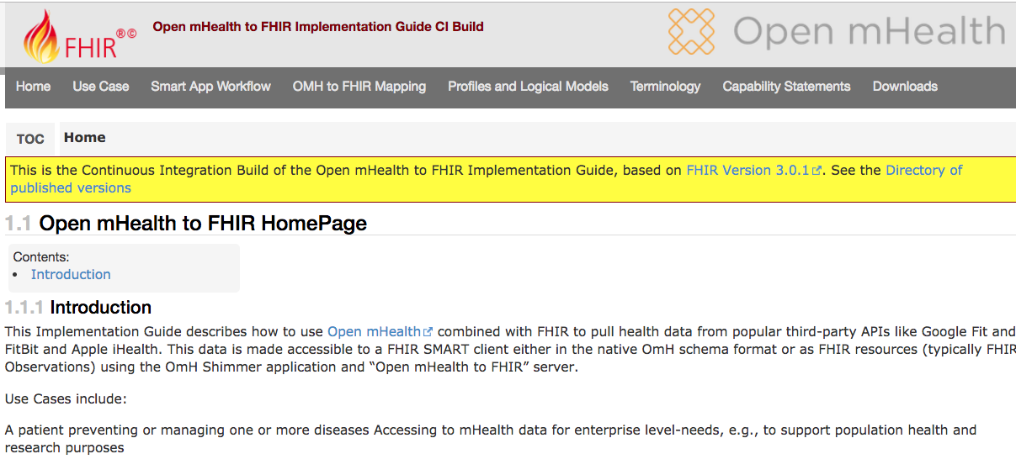
Open mHealth to FHIR Implementation Guide

Slide 30
Smart App workflow
Retrieving OMH data in native OMH Schema format
Retrieving OMH data as FHIR Observations
*Requires Mapping OMH to FHIR
EHR
OMH to FHIR Server
Patient Mobile Health Data

Slide 31

Smart App workflow: What is Smart
The SMART App Launch Framework connects third-party applications to Electronic Health Record data, allowing apps to launch from inside or outside the user interface of an EHR system.
- Based on *OAuth 2.0* authorization protocol.

Slide 32
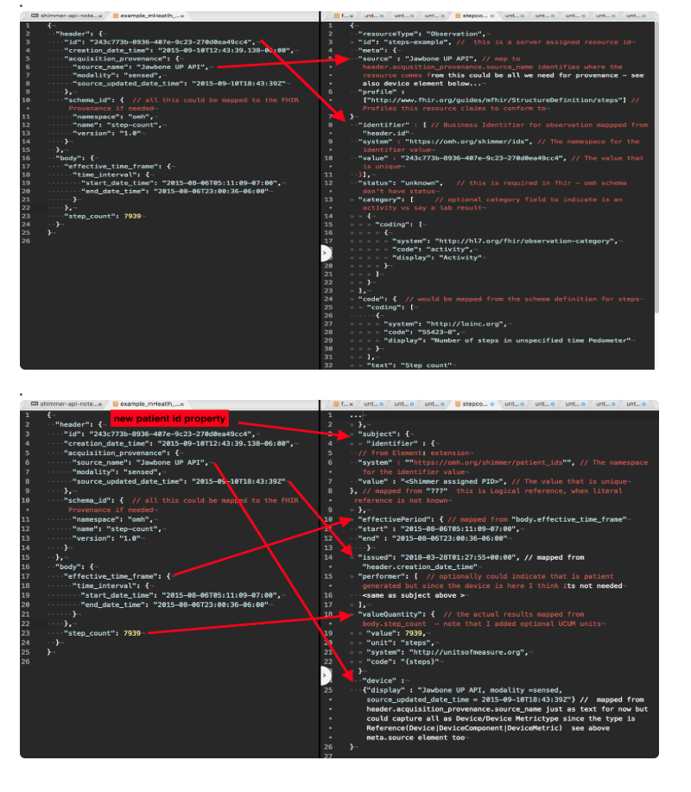
Mapping OMH to FHIR in Implementation Guide
Mappings based on OMH Schema and FHIR Observation Resource
Translations using mapping tables for codes and units

Slide 33
PS: What is CDS Hooks?
CDS Hooks a "hook"-based pattern for invoking real-time decision support from within a clinician's EHR workflow and triggering feedback in the form of a "CDS card" which are rendered and displayed by the EHR

Slide 34
Demo
Jon Duke, Eric Soto
Georgia Tech
November 5, 2018
SF MeetUp

Slide 35


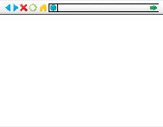






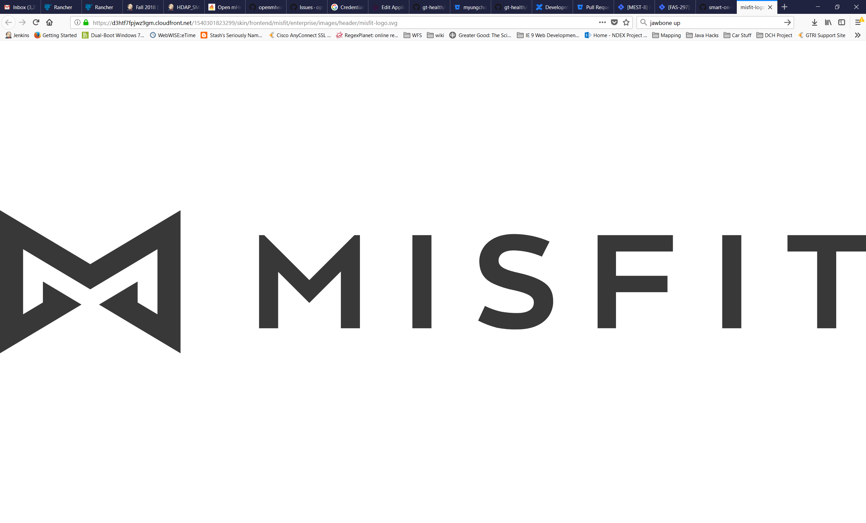




OMH on FHIR High Level Design
OMH on FHIR
Device
OMH on FHIR Web Service
EHR
Shimmer API
Google Fit
Launch
EHR FHIR Server
OMH on FHIR UI
Moves
OMH on FHIR Database
EHR OAuth

Slide 36
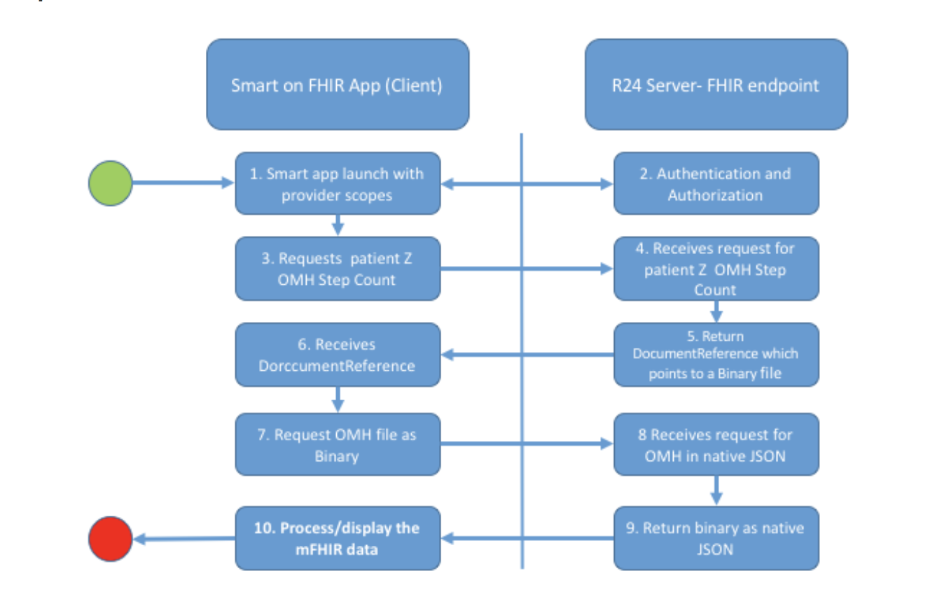
Smart App Workflow

